Slide 1

Developing an Intelligent Social Media Monitoring System to Strengthen
Afritech’s Brand Reputation
Segun Balogun

Slide 2

About AfriTech
AfriTech Electronics Ltd. is a dynamic force in the global consumer electronics industry, renowned for its innovation in smartphones, tablets, and wearable technology. Headquartered in the United States, the company has carved out a reputation for blending cutting-edge technology with premium quality and user-centric design. With a dedicated team of 200 employees, AfriTech is committed to pushing the boundaries of product excellence and delivering transformative digital experiences.
Since its inception, AfriTech has marked key milestones that reflect its growth and visionary leadership:
🚀 2017: Debuted its flagship smartphone series, redefining design and performance standards.
⌚ 2019: Expanded into wearable tech, reinforcing its market presence.
🤖 2021: Rolled out AI-driven features across product lines, enhancing personalization and functionality.
💰 2022: Surpassed $2 million in annual revenue, signaling strong global traction.
🌐 2025: Earned recognition as a top innovator in smart device integration.
AfriTech’s brand is built on a foundation of continuous innovation, design excellence, and strategic alignment with emerging tech trends. Its unwavering focus on consumer trust and long-term loyalty positions it as a trusted global brand in the fast-evolving electronics landscape.

Slide 3
AfriTech Electronics Ltd. is grappling with a significant brand reputation crisis driven by a surge in negative customer sentiment. Key issues include:
Negative Social Media Buzz: Widespread criticism of products and customer service is eroding public trust.
Customer Complaints: Rising dissatisfaction due to product defects, slow support response, and billing problems.
Product Recalls: High-profile recalls have triggered media scrutiny and customer anxiety.
📉 Impact on the Business
Loss of market share to competitors exploiting AfriTech’s reputation gaps.
Declining customer trust and satisfaction.
Reduced sales and heightened competitive pressure.
🎯 Strategic Rationale
To safeguard its brand and market position, AfriTech must:
Monitor and analyze social media sentiment in real time.
Prioritize and resolve customer issues swiftly.
Implement proactive crisis detection and communication strategies.
🧭 Project Objectives
Protect Market Position: Preserve brand equity and competitiveness.
Retain Customers: Improve satisfaction and reduce churn.
Mitigate Crises: Detect and address risks early.
Enable Data-Driven Decisions: Use sentiment insights to guide strategy.
Enhance Marketing: Align messaging with customer expectations.
Business
Challenge

Slide 4
Performance Highlights
Total Revenue: $37.5M, with consistent monthly growth from $1.5M in January to $2.8M in December.
Top Products by Revenue: Laptops ($15.9M), Smartphones ($13.5M), Tablets ($9.1M), Smartwatches ($6.3M).
Customer Base: 48K customers across 49 regions, with 62% being returning customers.
Purchase Frequency: High average of 240 purchases per customer, indicating strong repeat behavior.
Crisis & Complaint Insights
Avg Response Time: Increased from 158 days (2021) to 192 days (2023), signaling worsening support efficiency.
Unresolved Crises: 7K cases, with 52% from new customers—highlighting onboarding and product quality issues.
Product Recalls: 25K total, heavily concentrated in top regions like Montana, Nebraska, and West Virginia.
NPS Breakdown: 18K+ customers are detractors (score 0–6), compared to only 3.9K promoters (score 9–10), resulting in a low average NPS of 5.0.
Brand Sentiment & Social Media Engagement
Mentions: 181M brand mentions with 37M comments and 74M shares.
Sentiment Split: 27.65% negative, 25.59% positive, and 46.76% neutral—indicating a reputation imbalance.
Engagement by Age Group: Highest among 35–44 (80%) and 25–34 (75%), suggesting a strong mid-age demographic presence.
Platform Activity: TikTok and Twitter show high engagement across crisis, brand, and customer care categories.
EXECUTIVE
SUMMARY

Slide 5
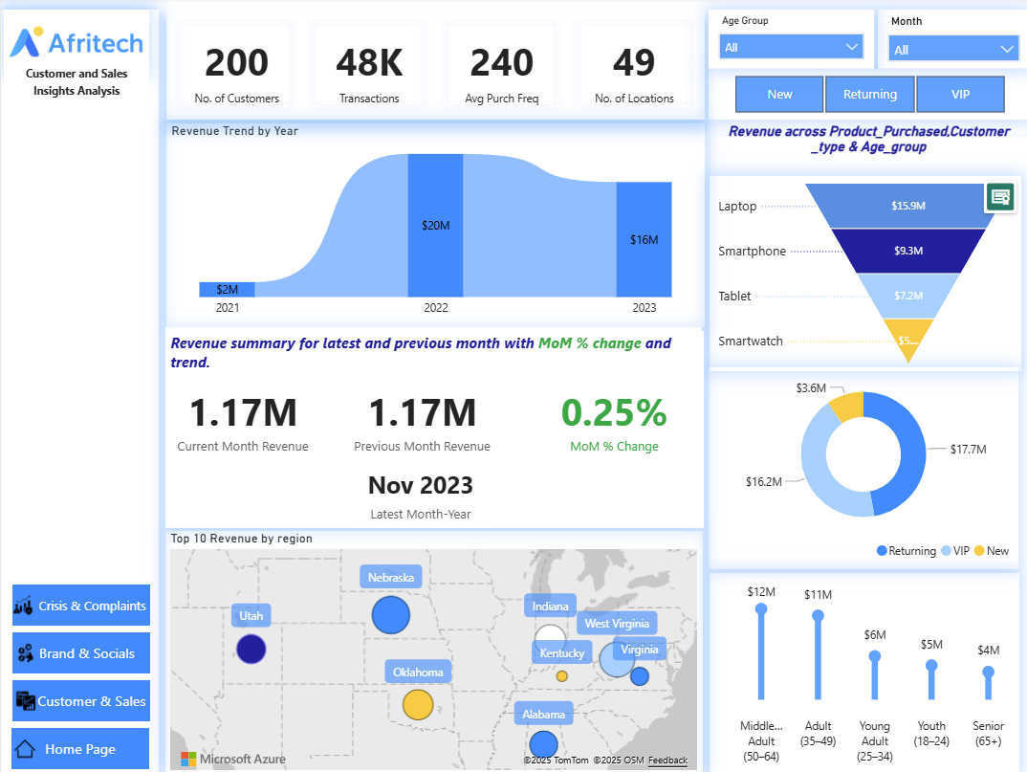
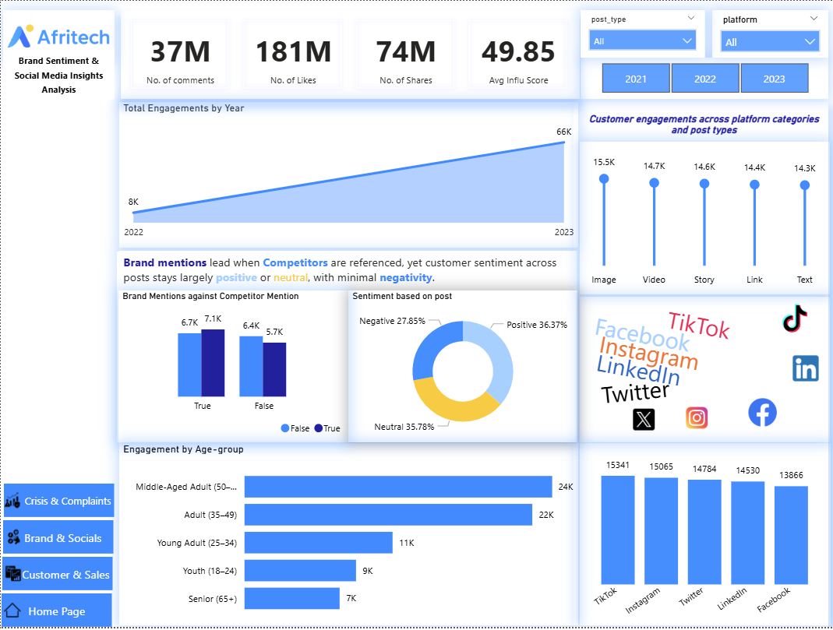
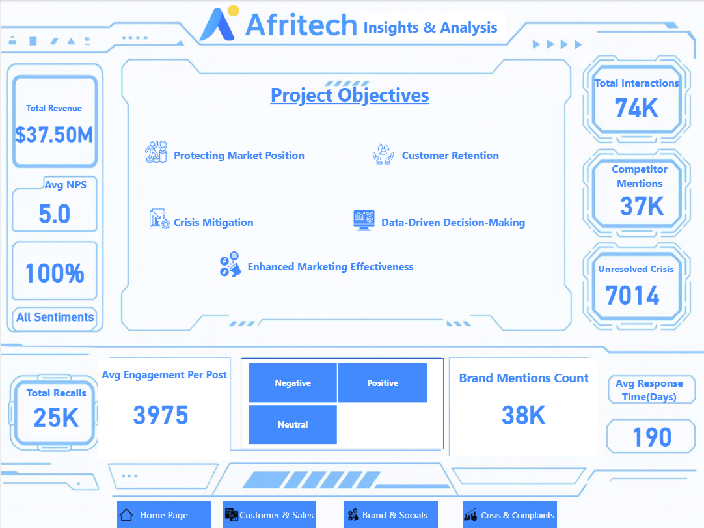
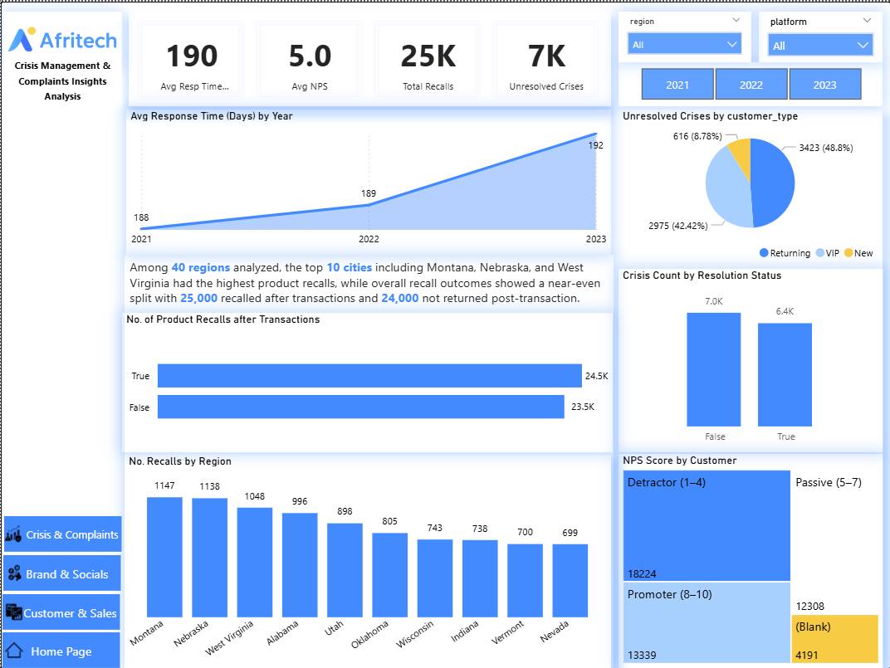
DASHBOARDS

Slide 6

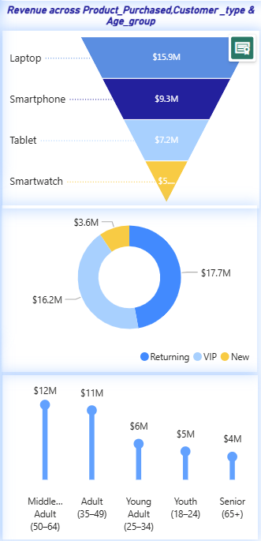
INSIGHTS & ANALYSIS
Revenue performance across product categories, customer segments, and age demographics reveals a clear concentration of sales among high-value items and loyal customer groups. Laptops generated the highest revenue at $15.9M, followed by smartphones ($9.3M), tablets ($7.2M), and smartwatches ($5.2M), confirming that premium devices continue to drive top-line growth. Returning and VIP customers contributed a combined $33.9M, while new customers accounted for just $3.6M, indicating strong retention but limited acquisition success. Age-wise, middle-aged adults (50–64) and adults (35–49) were the most profitable segments, generating $12M and $11M respectively, while younger groups lagged behind. This pattern suggests that AfriTech’s sales are sustained by mature, repeat buyers with high purchasing power, but future growth will depend on expanding appeal to younger demographics and converting new customers into long-term revenue contributors.

Slide 7
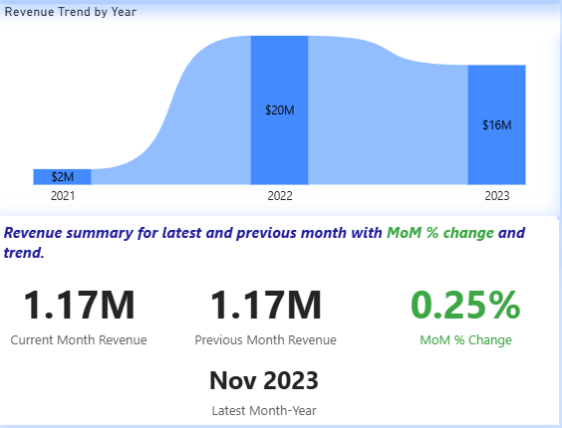
INSIGHTS & ANALYSIS
Revenue performance across product categories, customer segments, and age demographics reveals a clear concentration of sales among high-value items and loyal customer groups. Laptops generated the highest revenue at $15.9M, followed by smartphones ($9.3M), tablets ($7.2M), and smartwatches ($5.2M), confirming that premium devices continue to drive top-line growth. Returning and VIP customers contributed a combined $33.9M, while new customers accounted for just $3.6M, indicating strong retention but limited acquisition success. Age-wise, middle-aged adults (50–64) and adults (35–49) were the most profitable segments, generating $12M and $11M respectively, while younger groups lagged behind. This pattern suggests that AfriTech’s sales are sustained by mature, repeat buyers with high purchasing power, but future growth will depend on expanding appeal to younger demographics and converting new customers into long-term revenue contributors.

Slide 8
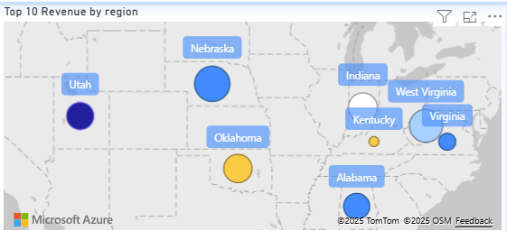
INSIGHTS & ANALYSIS
Revenue distribution highlights a strong concentration of sales in key U.S. states, with Utah emerging as the top-performing region out of 40 analyzed.
Utah leads with the highest revenue volume, followed by Nebraska, Virginia, Oklahoma, and Kentucky, each contributing significantly to overall performance. The dominance of these regions suggests that AfriTech’s market penetration is strongest in central and southeastern states, where customer engagement and product adoption appear to be highest. The variation in circle size and color across the map reflects not only revenue magnitude but also potential differences in product mix or customer type. This geographic concentration presents both an opportunity and a risk: while these regions are driving current sales, over-reliance on a few high-performing states could expose the business to localized disruptions. To sustain growth, AfriTech should explore expansion strategies in underperforming regions, replicate successful campaigns from top markets, and tailor regional offerings to maximize revenue potential across the full dataset.

Slide 9
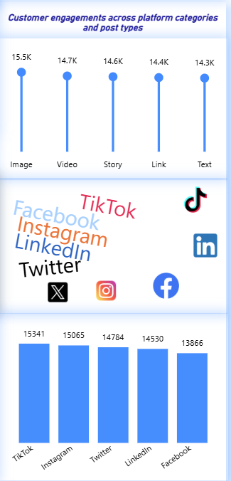
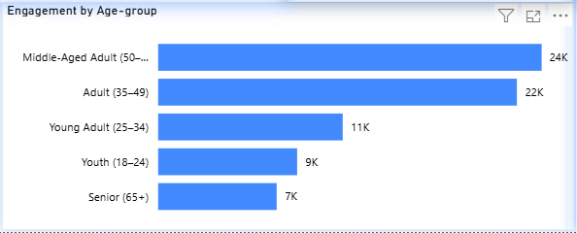
INSIGHTS & ANALYSIS
AfriTech’s social media engagement patterns reveal strong platform performance and age-group targeting opportunities that directly influence brand visibility and revenue growth.
Customer engagement is highest on TikTok (15.3K), Instagram (15.1K), and Twitter (14.8K), with image-based posts leading in effectiveness at 15.5K interactions, followed closely by video and story formats. This indicates that visually rich content is driving the most traction across platforms, making it essential for AfriTech to prioritize multimedia campaigns in its digital strategy. Age-wise, middle-aged adults (50–64) and adults (35–49) dominate engagement at 24K and 22K respectively, aligning with the same demographics that generate the highest revenue. However, younger segments such as youth (18–24) and young adults (25–34) show significantly lower engagement, suggesting a gap in content resonance or platform targeting. This mismatch presents a strategic opportunity: by tailoring creative content and platform-specific messaging to younger audiences, AfriTech can expand its reach, improve sentiment, and convert engagement into sales. Strengthening brand presence on high-performing platforms with age-appropriate content will be key to reversing sentiment challenges and unlocking new revenue streams.

Slide 10
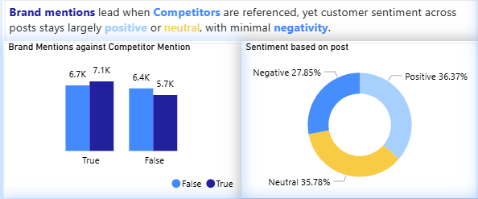
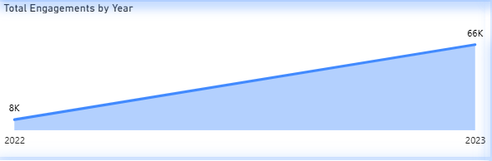
INSIGHTS & ANALYSIS
AfriTech’s brand sentiment and engagement trends show significant growth in visibility, but mixed emotional response and competitor overlap are limiting conversion into revenue.
Total engagements surged from 8K in 2022 to 66K in 2023, reflecting a major increase in audience interaction and content reach. This growth signals successful platform expansion and campaign visibility, yet sentiment analysis reveals that only 36.37% of posts are positive, while 27.85% are negative and 35.78% neutral, indicating that a substantial portion of engagement may not be translating into brand trust or purchase intent. Additionally, brand mentions are highest when competitors are referenced, suggesting that AfriTech’s visibility is often tied to comparative discussions rather than standalone brand strength. This dynamic poses a risk: while engagement volume is high, the emotional tone and competitive framing may dilute AfriTech’s value proposition and hinder revenue conversion. To capitalize on rising engagement, AfriTech must shift sentiment toward positivity through targeted messaging, influencer partnerships, and proactive customer support. Strengthening brand identity independent of competitor comparisons will be key to turning visibility into sustained revenue growth.

Slide 11
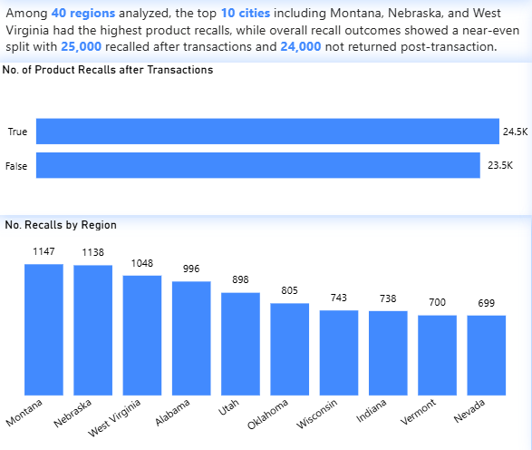
INSIGHTS & ANALYSIS
AfriTech’s crisis management data reveals a high volume of product recalls concentrated in key regions, with nearly half occurring post-transaction posing a direct threat to customer trust and revenue retention.
Among the 40 regions analyzed, the top 10 including Montana (1,147 recalls), Nebraska (1,138), and West Virginia (1,048) account for a disproportionate share of product issues, suggesting localized quality control or distribution challenges. The recall split shows 24.5K occurred after transactions, compared to 23.5K before, meaning a significant number of customers experienced product failures after purchase, which amplifies dissatisfaction and increases the likelihood of churn. This post-sale recall pattern not only damages brand reputation but also undermines repeat purchase behavior, especially in high-revenue regions. If unresolved, these issues could erode AfriTech’s stronghold in its top-performing markets and weaken long-term revenue streams. To mitigate this, AfriTech must prioritize regional root-cause analysis, strengthen post-sale support, and implement proactive recall communication strategies to preserve customer loyalty and protect future sales.

Slide 12
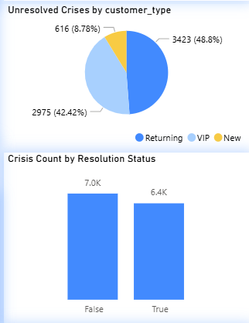
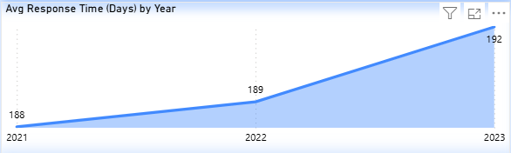
INSIGHTS & ANALYSIS
AfriTech’s crisis resolution performance has directly impacted brand trust and contributed to the revenue decline from 2022 to 2023, driven by rising unresolved cases and worsening response times.
Out of a total of 13.4K recorded crises, 7K remain unresolved, with VIP and returning customers accounting for over 91% of these cases a critical concern given their high contribution to revenue. Only 6.4K crises were resolved, indicating that nearly half of all issues persist, undermining customer confidence and loyalty. The average response time has steadily worsened, rising from 188 days in 2021 to 192 days in 2023, reflecting operational inefficiencies and delayed support. This sluggish responsiveness, especially in handling high-value customer complaints, has likely accelerated churn and eroded repeat purchase behavior. The timing aligns with AfriTech’s revenue drop from $20M in 2022 to $16M in 2023, suggesting that unresolved crises and poor service delivery have materially weakened sales performance. To reverse this trend, AfriTech must urgently streamline its crisis resolution workflows, prioritize VIP and returning customer support, and reduce response times to restore trust and stabilize revenue.

Slide 13
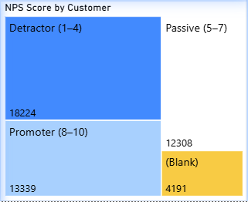
INSIGHTS & ANALYSIS
AfriTech’s Net Promoter Score (NPS) distribution reveals a concerning imbalance in customer sentiment, with detractors significantly outnumbering promoters posing a direct risk to brand loyalty and future revenue.
Out of the total customer base analyzed, 18,224 customers fall into the detractor category (scores 1–4), compared to only 13,339 promoters (scores 8–10) and 12,308 passives (scores 5–7). This skewed sentiment profile suggests that a large portion of AfriTech’s customers are dissatisfied or unlikely to recommend the brand, which correlates with the unresolved crisis volumes and long response times previously observed. The presence of 4,191 blank entries also indicates gaps in feedback collection, limiting the company’s ability to act on sentiment data. This imbalance in NPS not only reflects weakened customer trust but also helps explain the revenue decline from $20M in 2022 to $16M in 2023, as negative sentiment often leads to reduced repeat purchases and poor word-of-mouth. To reverse this trend, AfriTech must prioritize service recovery for detractors, enhance post-sale support, and actively convert passives into promoters through personalized engagement and loyalty initiatives. A healthier NPS distribution will be critical to restoring brand equity and driving sustainable revenue growth.

Slide 14

URGENT ACTION
1.
🔧 Short-Term Actions (0–3 months): Immediate Stabilization
Resolve High-Impact Crises: Prioritize unresolved issues among VIP and returning customers, especially in top-revenue regions like Utah and Nebraska. Fast-track resolution workflows and assign dedicated support teams.
Reduce Response Time: Implement a rapid-response protocol to bring average resolution time below 100 days. Use auto-replies, escalation flags, and CRM alerts to triage complaints faster.
Sentiment Recovery Campaigns: Launch targeted outreach to detractors (NPS 1–4) with apology messages, discounts, or loyalty incentives to rebuild goodwill and prevent churn.
Content Optimization: Focus social media efforts on high-engagement formats (images, videos) and platforms (TikTok, Instagram). Tailor messaging to middle-aged and adult segments who show both high engagement and revenue contribution.
Recall Communication Strategy: Proactively notify affected customers in high-recall regions with transparent updates and resolution timelines to mitigate reputational damage.
2.
🧩 Medium-Term Actions (3–9 months): Structural Improvements
These initiatives strengthen internal systems and customer experience.
Customer Journey Mapping: Analyze pain points across the post-transaction lifecycle to identify where sentiment drops and crises emerge. Use this to redesign onboarding and support flows.
NPS-Driven Segmentation: Create tailored engagement strategies for promoters, passives, and detractors. Convert passives into promoters through personalized offers and feedback loops.
Platform Diversification: Expand engagement efforts to underperforming platforms like Facebook and LinkedIn with age-specific content to reach younger demographics.
Regional Quality Audits: Investigate product issues in top-recall cities and implement stricter QA protocols in those supply chains.
Sentiment Monitoring System: Deploy real-time sentiment tracking across social and support channels to catch negative trends before they escalate.
3.
🚀 Long-Term Actions (9–24 months): Strategic Growth
These are transformative initiatives to future-proof AfriTech’s brand and revenue.
Customer Experience Overhaul: Invest in AI-powered support systems, omnichannel service integration, and predictive complaint resolution to deliver seamless customer care.
Brand Positioning Shift: Move away from competitor-dependent visibility and build a standalone brand narrative focused on innovation, reliability, and customer empowerment.
Product Innovation & Diversification: Use engagement and complaint data to inform new product development, especially for younger age groups and regions with low penetration.
Loyalty & Advocacy Programs: Formalize promoter engagement through referral incentives, ambassador programs, and exclusive access to new releases.
Data-Driven Culture: Embed analytics into every decision-making layer—from marketing to operations—to ensure continuous feedback and agile response to market shifts.

Slide 15
RECOMMENDATION
Customer Experience & Retention
Launch a Customer Recovery Program: Focus on detractors and unresolved VIP/returning customer cases. Offer personalized outreach, compensation, and fast-tracked support to rebuild trust.
Shorten Response Time Targets: Set a 30-day maximum response time goal for all crises. Use automation and escalation protocols to meet it.
Implement Post-Transaction Feedback Loops: Ensure every customer who transacts is prompted for feedback, and act on it within 7 days to show responsiveness.
📊 Sales & Revenue Optimization
Re-engage High-Value Age Segments: Middle-aged and adult customers drive both revenue and engagement—double down on loyalty programs, exclusive offers, and tailored messaging.
Boost New Customer Conversion: With new customers contributing only $3.6M, redesign onboarding flows, offer first-time incentives, and track conversion from engagement to purchase.
Expand Regional Sales Strategy: Replicate successful campaigns from top-performing states (e.g., Utah, Nebraska) in underperforming regions using localized content and offers.
📣 Brand & Social Media Strategy
Shift Sentiment from Neutral to Positive: Use storytelling, customer testimonials, and influencer partnerships to emotionally connect with audiences and elevate brand perception.
Optimize Content for High-Engagement Formats: Prioritize image and video posts on TikTok and Instagram, where engagement is strongest. Use age-specific targeting to reach younger segments.
Monitor Competitor Mentions: Since brand visibility often spikes when competitors are referenced, develop proactive messaging that highlights AfriTech’s unique value without relying on comparisons.
🛠️ Crisis Management & Operational Efficiency
Conduct Root-Cause Analysis in High-Recall Regions: Investigate Montana, Nebraska, and West Virginia for systemic issues in product quality or logistics.
Create a Crisis Dashboard: Track resolution status, response times, and sentiment impact in real time to guide executive decisions.
Train Support Teams on Empathy & Speed: Equip frontline staff with tools and scripts to handle complaints swiftly and compassionately, especially for VIPs.
🔮 Strategic Growth & Innovation
Invest in Predictive Analytics: Use engagement, sentiment, and complaint data to forecast churn and proactively intervene.
Develop Youth-Focused Product Lines: Engagement among younger age groups is low—introduce affordable, trend-driven tech products with targeted campaigns.
Build a Brand Advocacy Program: Turn promoters into brand ambassadors with referral bonuses, early access to new products, and community-building initiatives.

